Slide 1
Leak DeTECTION AND WATER LOSS
Ward Heidbreder
NDRWSA CIRCUIT RIDER

Slide 3
What is a leak?

Slide 4
A leak can be defined as the uncontrolled loss of water due to pipe fatigue, extreme water line stresses or accidents.

Slide 5
Leaks are responsible for two trillion gallons of treated water lost each year

Slide 6
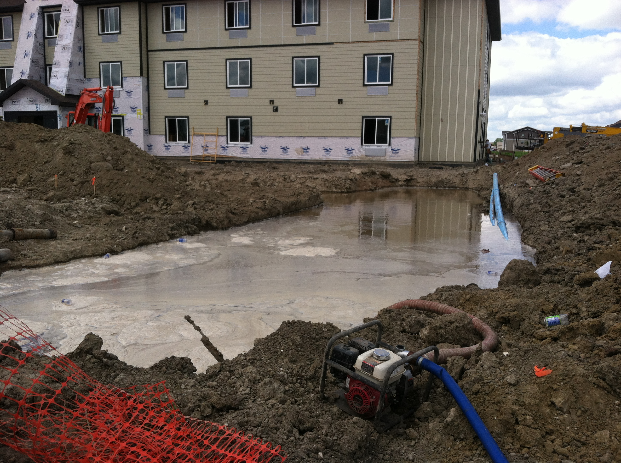

Slide 7
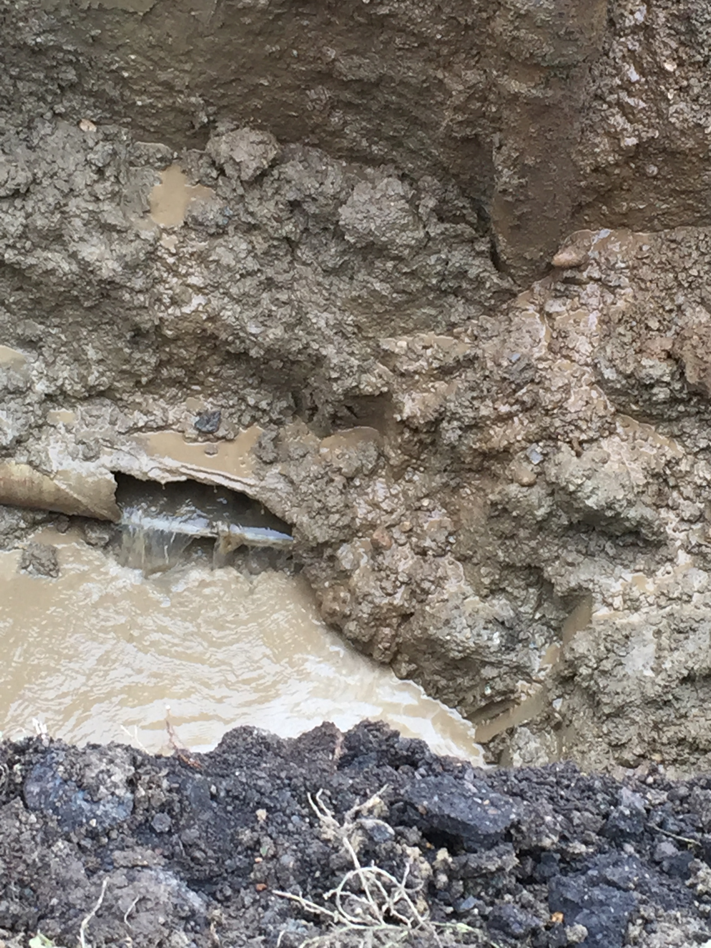

Slide 8
What
is water loss?

Slide 9
Water loss can be:
Accounted for
Unaccounted for

Slide 10
Water meters tell the truth

Slide 11
Master meters
Meter accuracy and age
Water loss audits

Slide 14
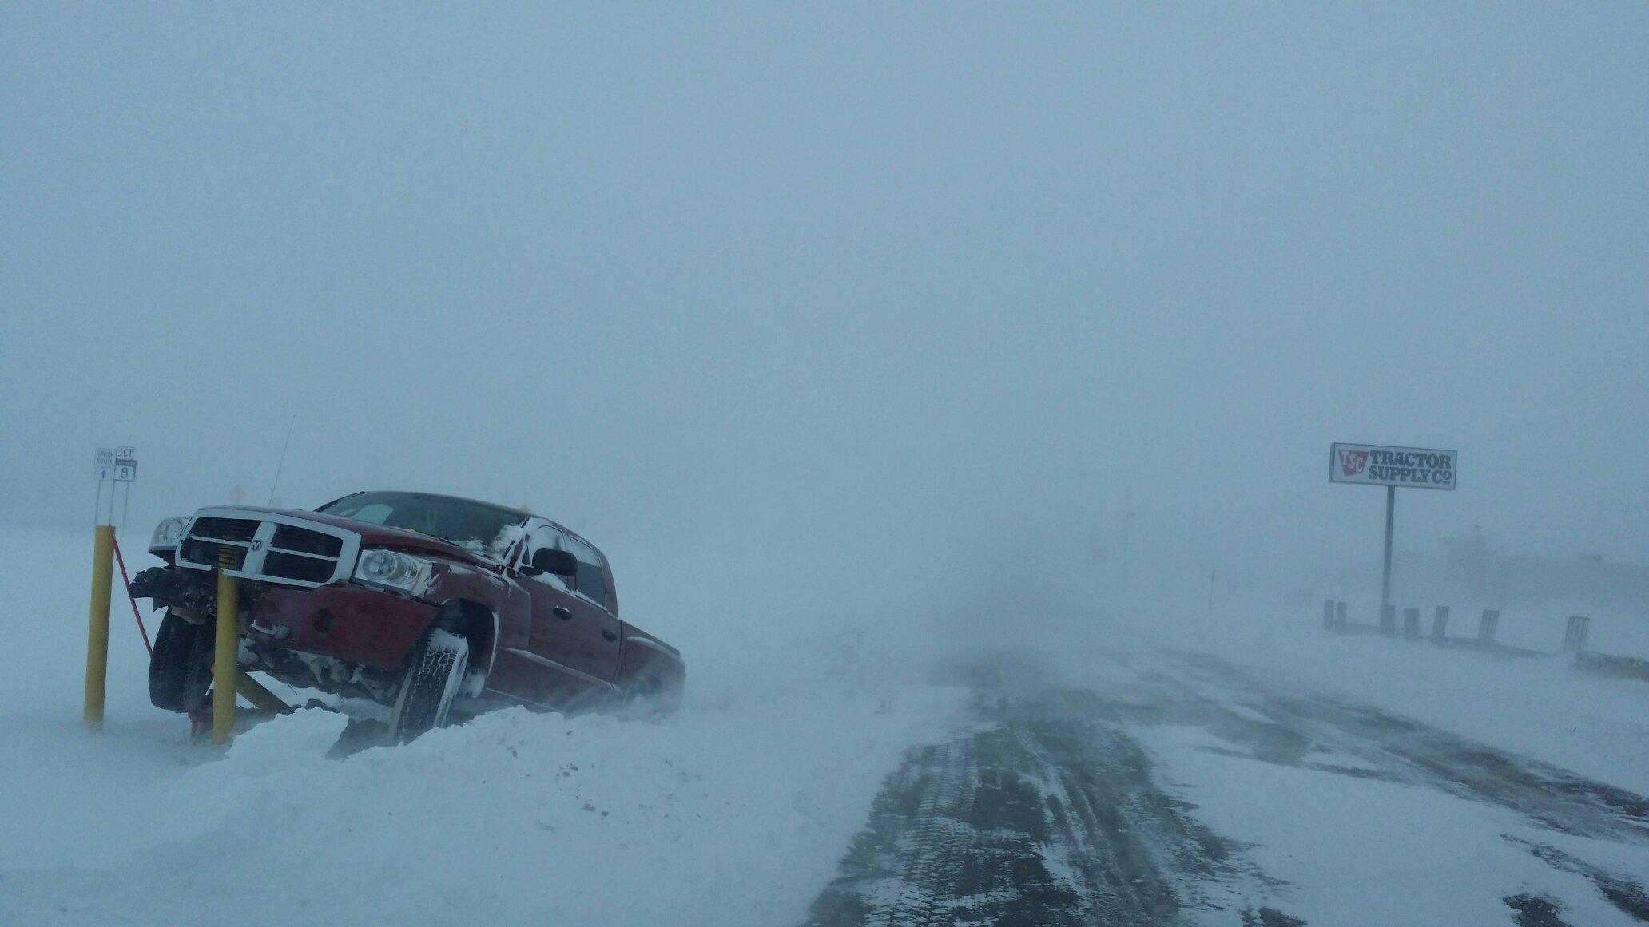

Slide 15
Tools of the trade

Slide 17
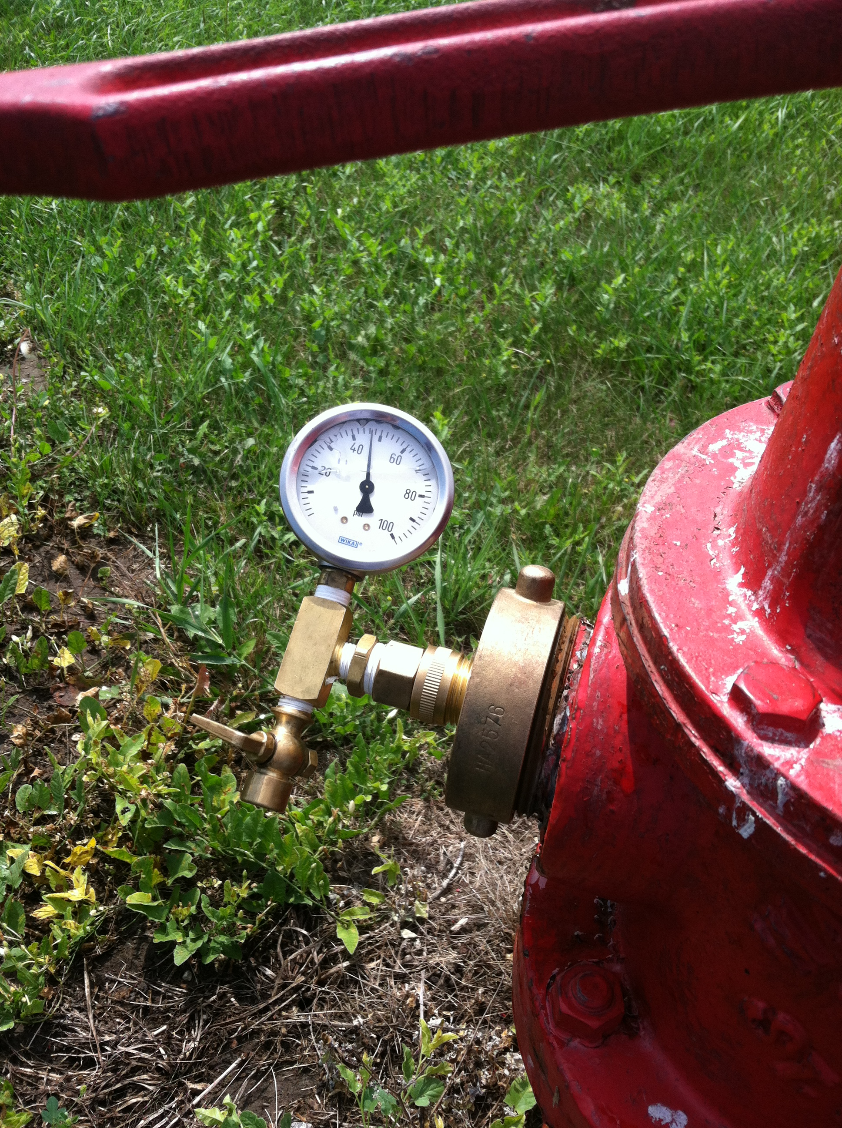

Slide 20
THE BEST TOOL YOU HAVE IS THE CONSUMER!!!!

Slide 21
HELPFUL LINKS https://www3.epa.gov/watersense/pubs/fixleak.html

Slide 22
